Slide 1


2024
Ray Direction Selection Based on Sampling Distributions
Xuan Zhang
1th June, 2025

Slide 2
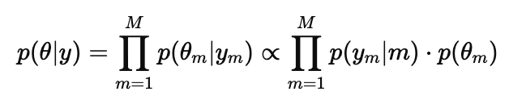
Sample a set of angles 𝜃 _{i}∼𝑝 (𝜃｜y) according to the posterior distribution
Structure of the posterior:
Uniform Prior : p(𝜃 ) = constant, p(𝜃 | y) ∝ p(y | 𝜃 )
Gaussian Prior + Gaussian Likelihood => Posterior : Gaussian
Von Mises Prior + Von Mises Likelihood : VM(μ₁,κ₁) x VM(μ₂,κ₂) => VM(μ,κ)
How to Sample from the Posterior:
Monte Carlo methods (MCMC) - Metropolis-Hastings(MH) algorithm

Slide 3
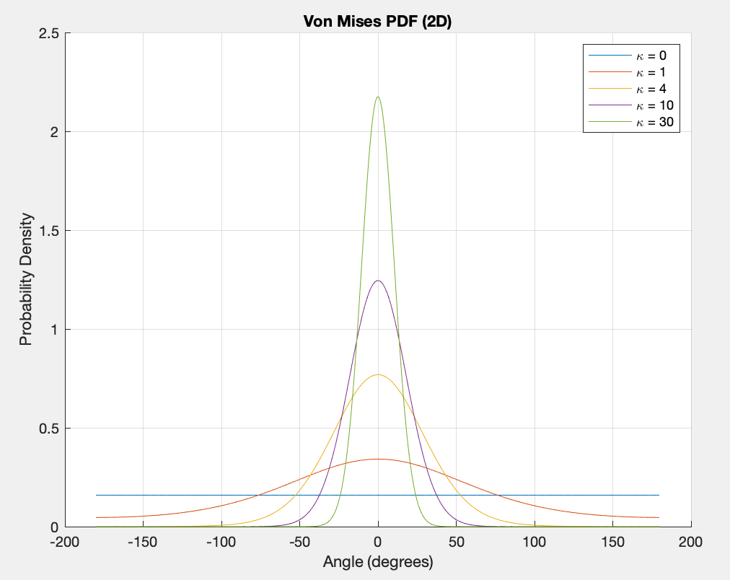
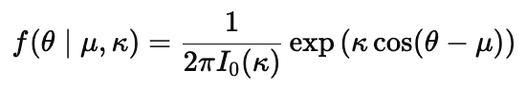
von Mises Distribution
Probability Density Function (PDF)
θ : angle (in radians)
μ : mean direction (center)
κ : concentration parameter (analogous to precision in Gaussian)
I₀(κ) : modified Bessel function of order 0
Key Properties
Periodic : Naturally handles circular data (e.g., -π ≡ π)
κ = 0 : Uniform distribution over the circle
Large κ : Distribution concentrates around μ
Used in : Directional statistics, localization, orientation estimation

Slide 4
How to sample from the posterior - Monte Carlo methods(MCMC)
Key Idea
MCMC constructs a Markov chain whose stationary distribution is the target distribution p∗(x) .
We perform a random walk in the state space, so that the proportion of time spent in each state matches p∗(x).
How It Works
Initial samples (before convergence) are discarded — this period is called the mixing time or burn-in time.
After convergence, samples can be used for Monte Carlo integration and other probabilistic inference tasks.
Strengths
Especially useful for sampling in high-dimensional spaces where traditional methods fail.
Widely used in Bayesian inference, statistical physics, and machine learning.

Slide 5
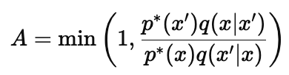
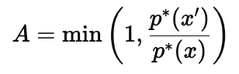
How to sample from the posterior - Metropolis-Hastings(MH) algorithm
Basic Idea
Proposal : From current state x, propose a new state x′∼q(x′|x) using a proposal distribution q.
Acceptance Rule: Accept x′ with probability
If accepted, move to x′; else stay at x.
If q is symmetric, it simplifies to :

Slide 6
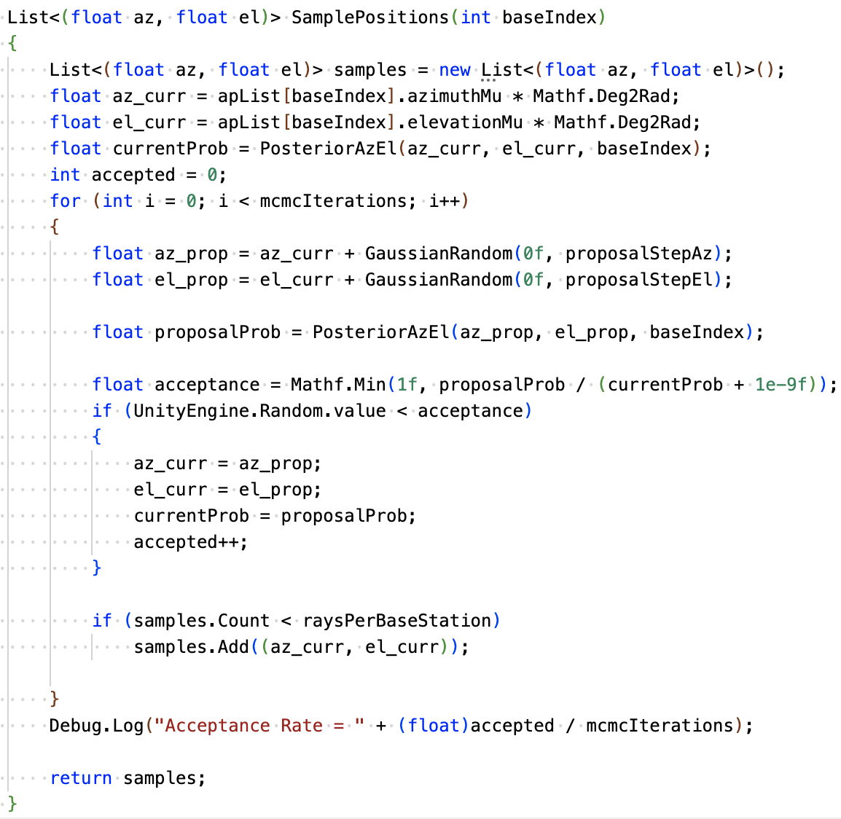
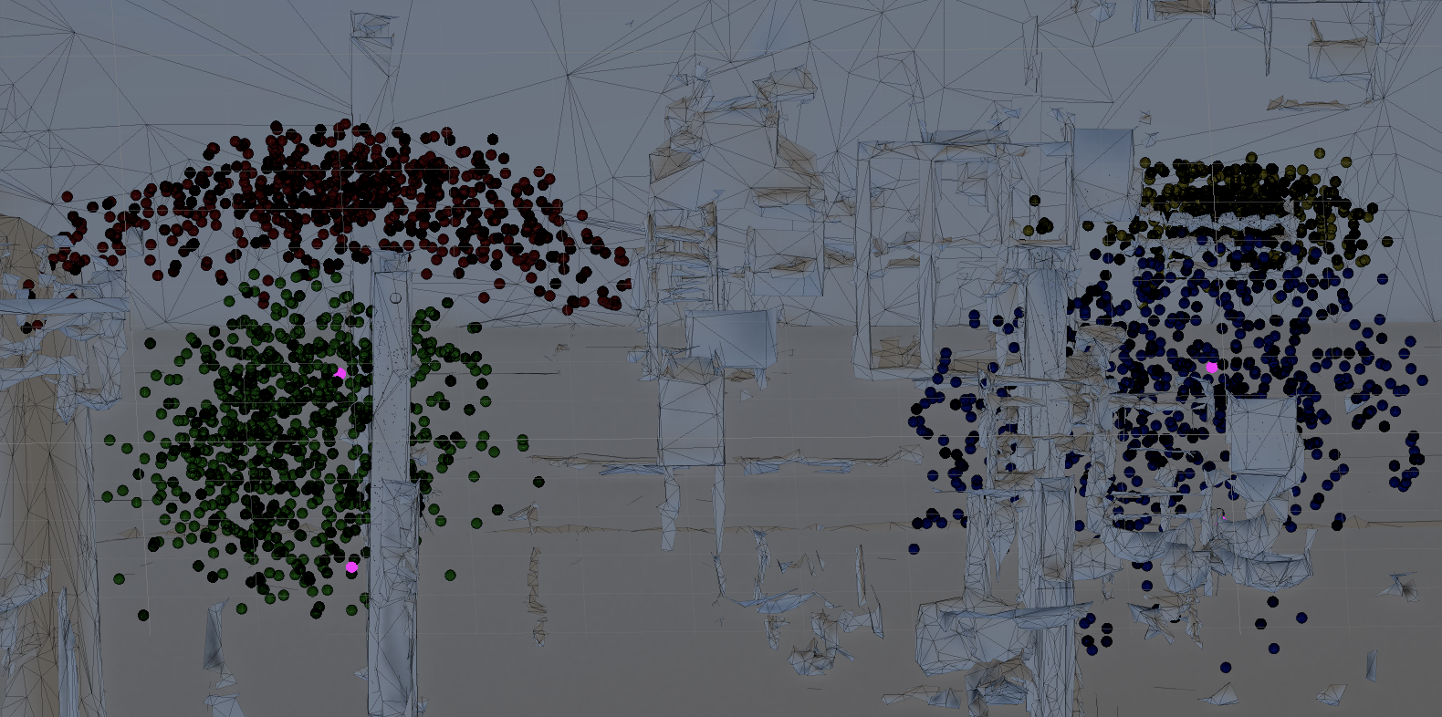
How to sample from the posterior - Metropolis-Hastings(MH) algorithm
proposalStepAz
- step size (in radians) for the azimuth proposal; controls the perturbation ratio.
proposalStepEl
- step size (in radians) for the elevation proposal; similar to above.
mcmcIterations
- total number of MCMC iterations; set to 1000 to ensure sampling quality.
If proposalStepAz and proposalStepEl increase, the acceptance will also decrease. Finally, proposalStepAz and proposalStepEl are selected as 0.15, and the acceptance is around 0.5.
1e-9f is added to prevent division by zero from causing a program crash

Slide 7
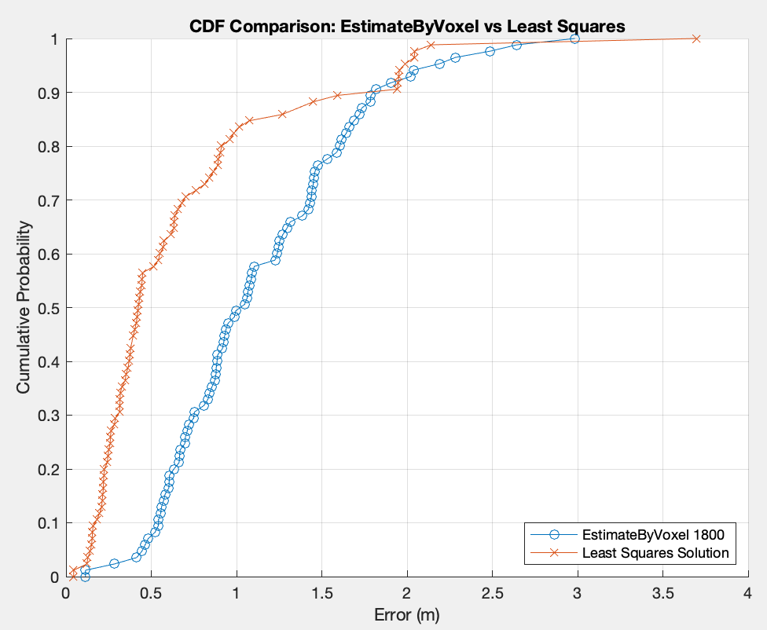
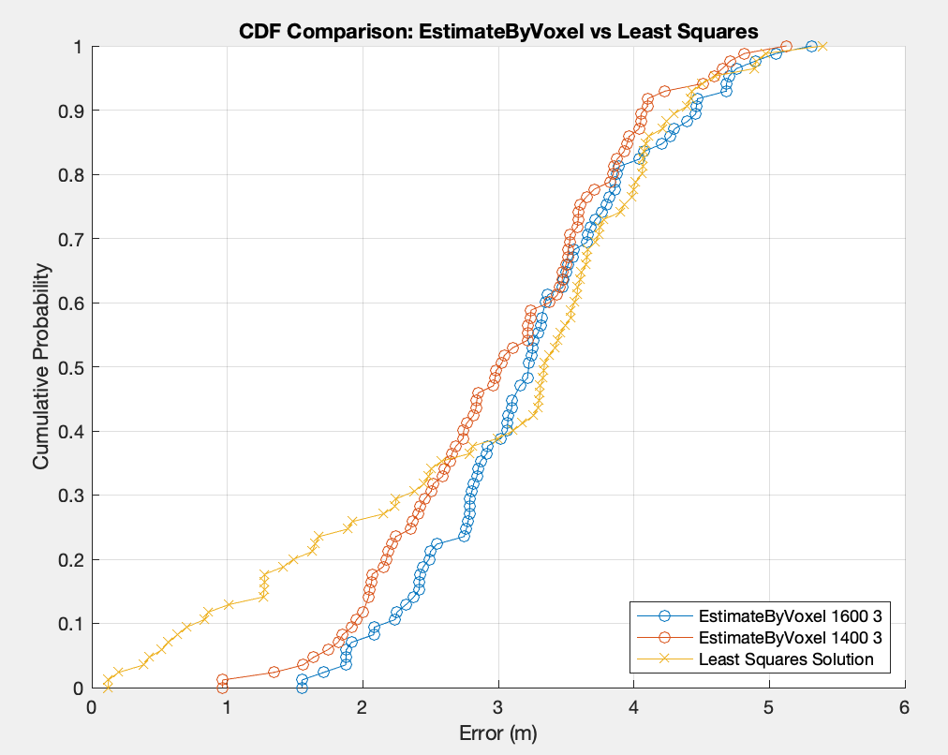
Result(Gaussian Distribution~(0, (MaxDegree - MinDegree)/6))
made-data-test-1.mat
made-data-test-2.mat

Slide 8
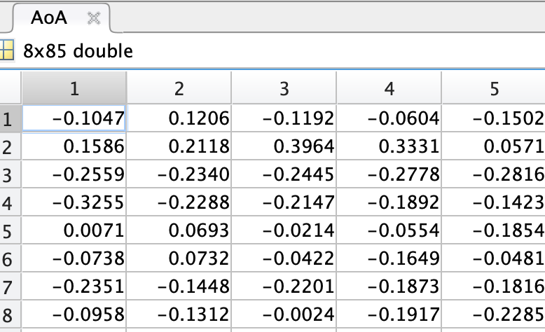
Parameter selection for Gaussian distribution
Dataset | AP | Azimuth_mu_deg | Azimuth_sigma_deg | Elevation_mu_deg | Elevation_sigma_deg
made-data-test-1.mat | AP1 | -11.62037931 | 26.37860942 | -12.76095305 | 7.506369306
 | AP2 | -9.672270097 | 16.64703058 | -2.888638554 | 18.35732067
 | AP3 | -6.625160694 | 23.45056757 | -3.195065489 | 16.51235479
 | AP4 | 5.446863915 | 11.61458236 | -7.973798569 | 6.408666647
made-data-test-2.mat | AP1 | -11.82804409 | 26.4067908 | -12.42793578 | 7.831385597
 | AP2 | -9.428111165 | 15.85714655 | -3.07439494 | 18.37763331
 | AP3 | -5.541312273 | 23.69471921 | -3.398504146 | 14.78050808
 | AP4 | 5.406071168 | 10.93963516 | -7.806305047 | 6.37271112
made-data-test-3.mat | AP1 | -11.82804409 | 26.4067908 | -12.42793578 | 7.831385597
 | AP2 | -9.428111165 | 15.85714655 | -3.07439494 | 18.37763331
 | AP3 | -5.541312273 | 23.69471921 | -3.398504146 | 14.78050808
 | AP4 | 5.406071168 | 10.93963516 | -7.806305047 | 6.37271112
AVG | AP1 | -9.672270097 | 26.39739701 | -12.53894154 | 7.723046834
 | AP2 | -9.509497476 | 16.12044123 | -3.012476145 | 18.37086243
 | AP3 | -5.90259508 | 23.61333533 | -3.33069126 | 15.35779032
 | AP4 | 5.41966875 | 11.16461756 | -7.862136221 | 6.384696296

Slide 9
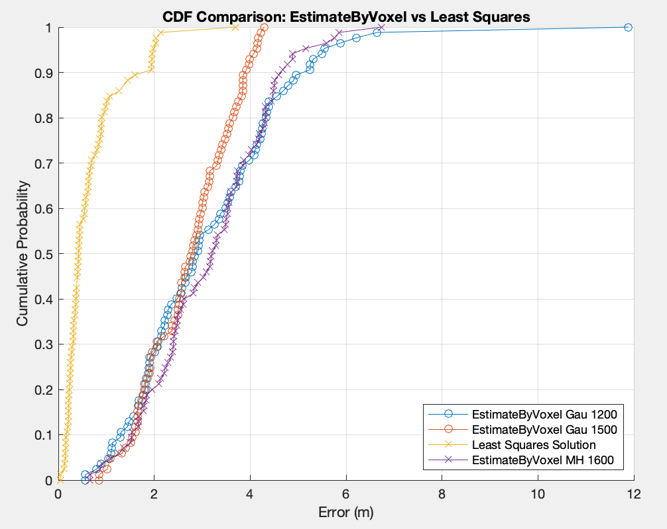
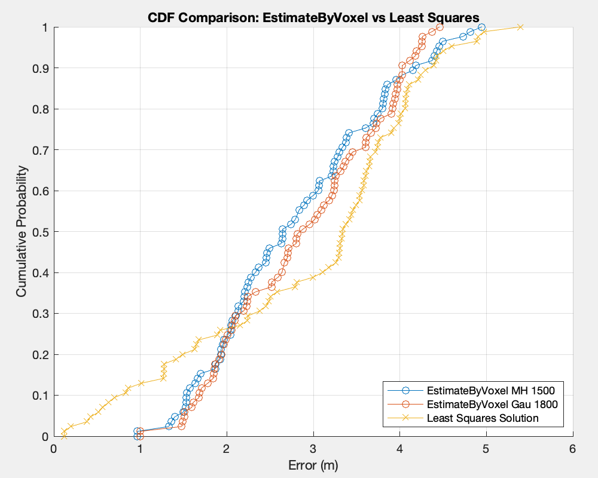
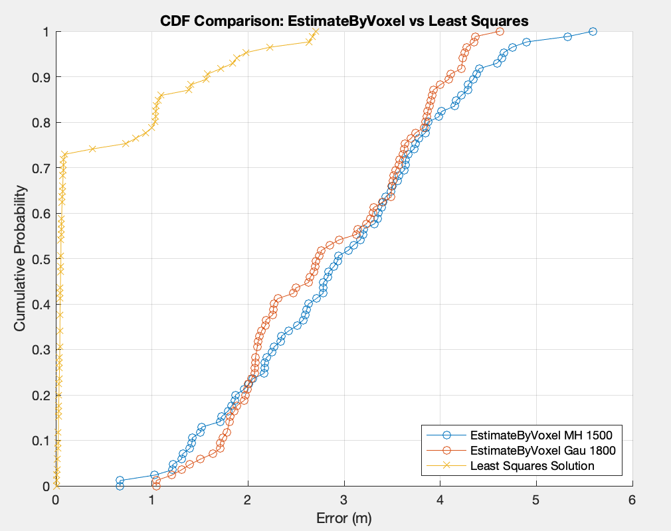
Result
made-data-test-1.mat
made-data-test-2.mat
made-data-test-3.mat

Slide 10
Parameter selection for distribution
The table on the left is the von Mises distribution of the AOA measured by each AP. (The visualization statistics of these parameters are placed at the end of the slides)
Dataset | AP | Azimuth μ(deg) | Azimuth k | Elevation μ(deg) | Azimuth k
made-data-test-1.mat | AP1 | -11.6 | 5.53 | -12.7 | 59.96
 | AP2 | -9.7 | 12.84 | -3.6 | 11.23
 | AP3 | -6.6 | 7.07 | -3.8 | 14.03
 | AP4 | 5.5 | 25.51 | -8.0 | 82.22
made-data-test-2.mat | AP1 | -11.8 | 5.52 | -12.4 | 55.16
 | AP2 | -9.5 | 14.07 | -3.8 | 11.19
 | AP3 | -5.5 | 6.98 | -3.8 | 16.82
 | AP4 | 5.4 | 28.65 | -7.8 | 82.89
made-data-test-3.mat | AP1 | -11.6 | 5.82 | -12.5 | 75.73
 | AP2 | -9.3 | 14.15 | -4.0 | 11.17
 | AP3 | -6.5 | 6.64 | -4.2 | 15.96
 | AP4 | 5.2 | 29.19 | -7.5 | 131.58
AVG | AP1 | -11.67 | 5.62 | -12.53 | 63.62
 | AP2 | -9.5 | 13.69 | -3.8 | 11.20
 | AP3 | -6.2 | 6.90 | -3.93 | 15.60
 | AP4 | 5.37 | 27.78 | -7.77 | 98.90

Slide 11
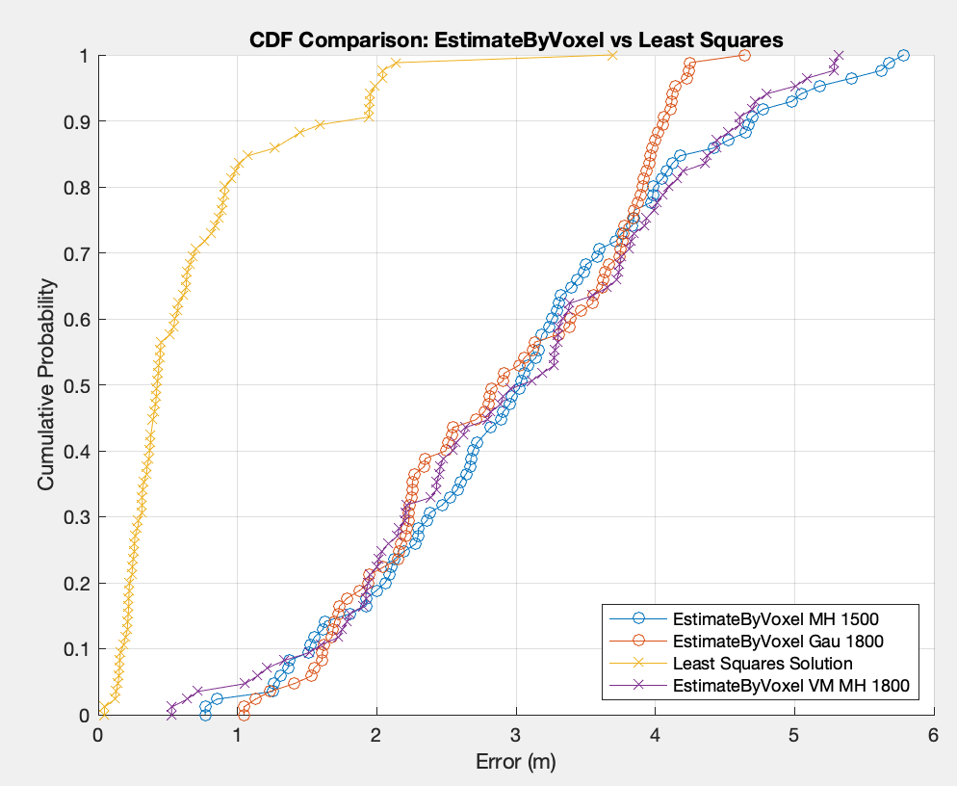
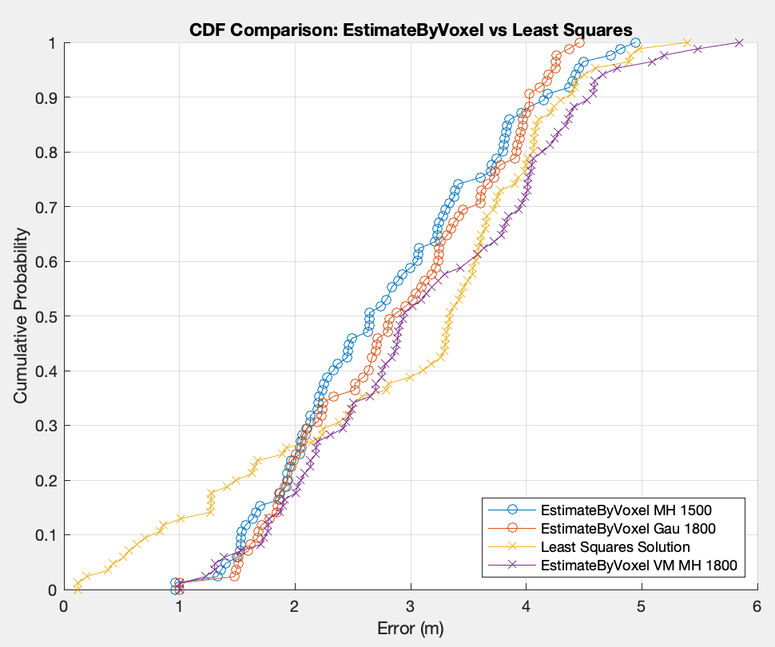
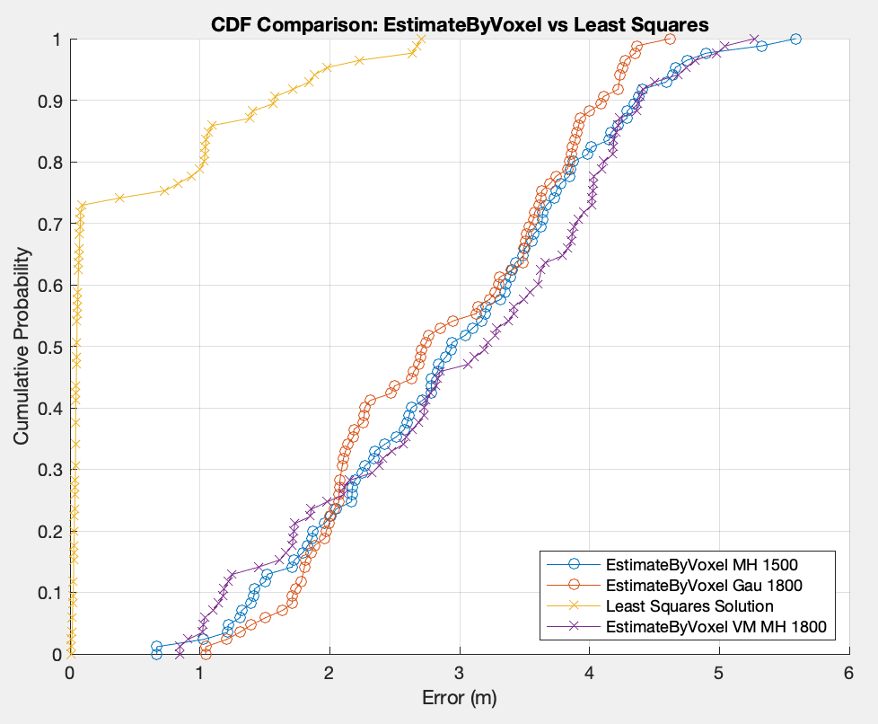
Result
made-data-test-1.mat
made-data-test-2.mat
made-data-test-3.mat

Slide 12
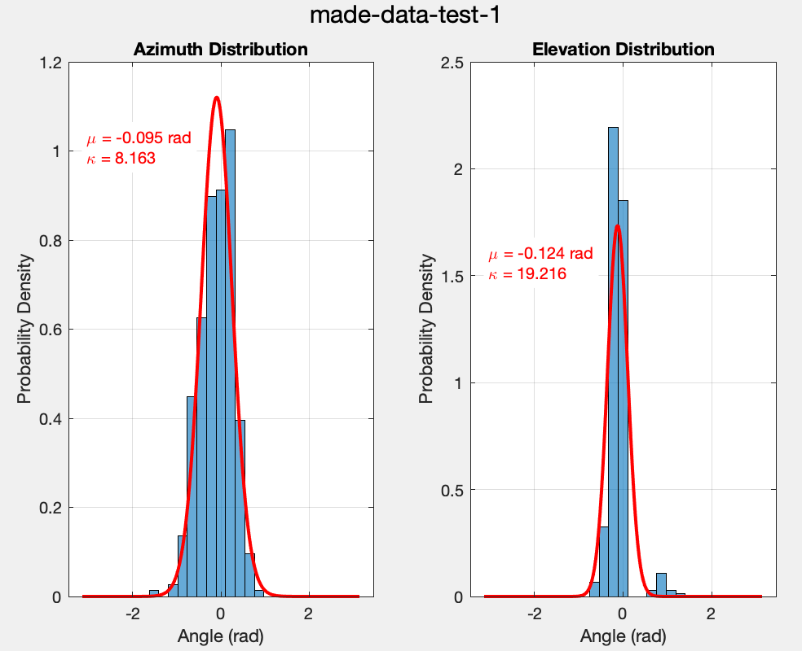
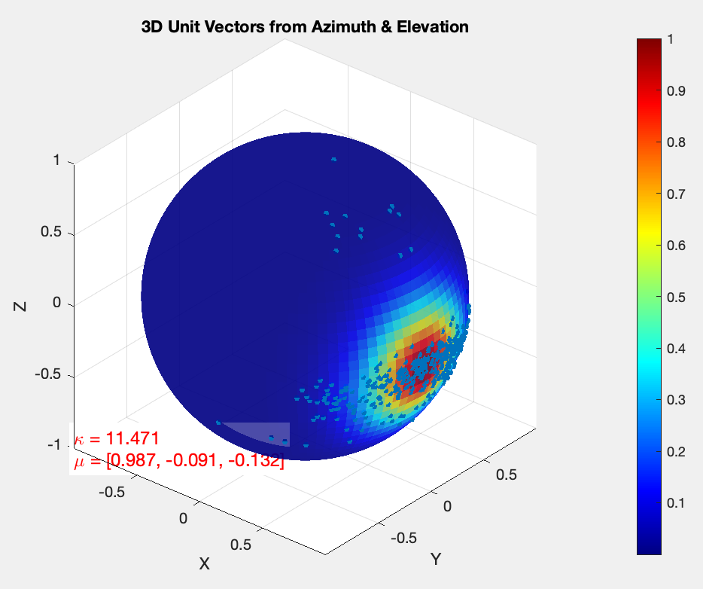
Distribution parameters of azimuth and elevation - made-data-test-1

Slide 13
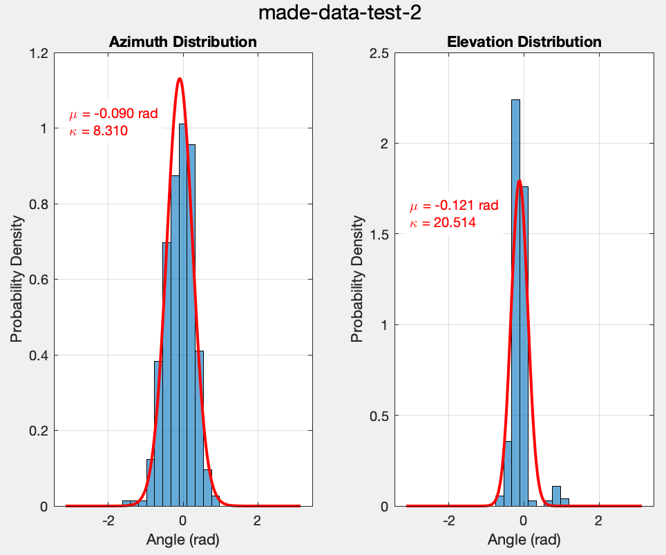
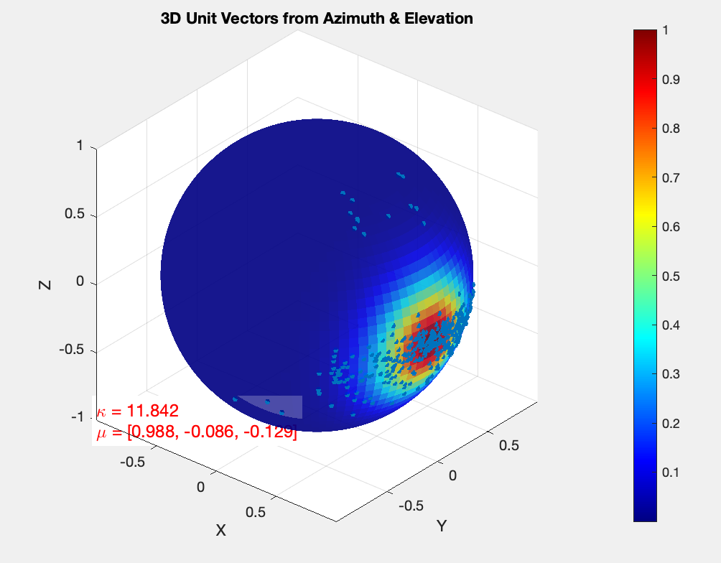
Distribution parameters of azimuth and elevation - made-data-test-2

Slide 14
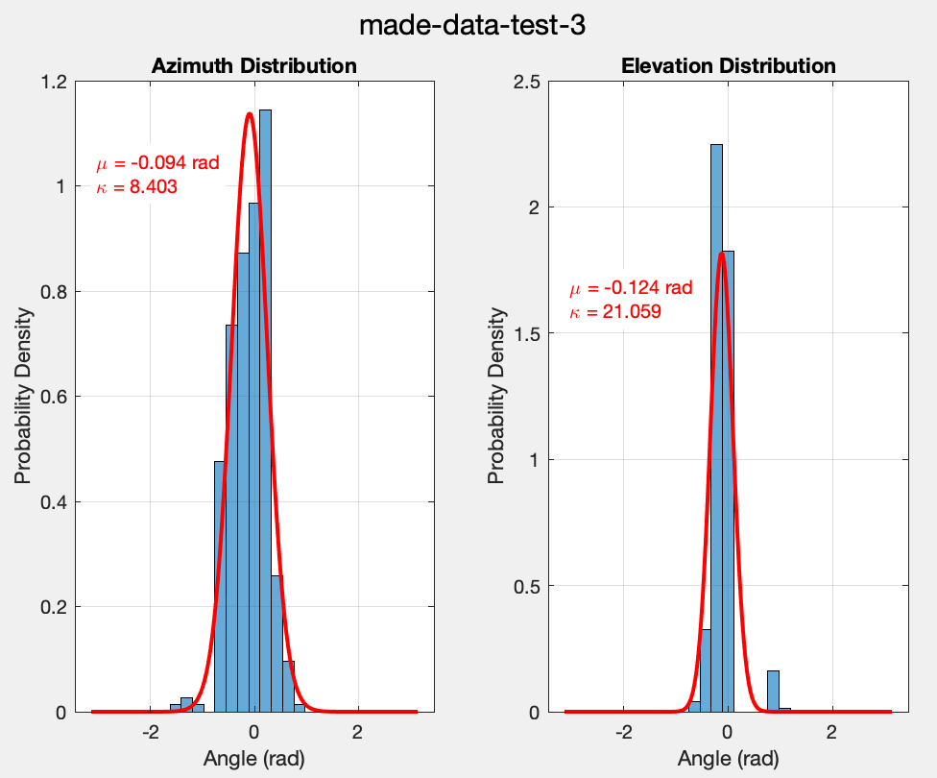
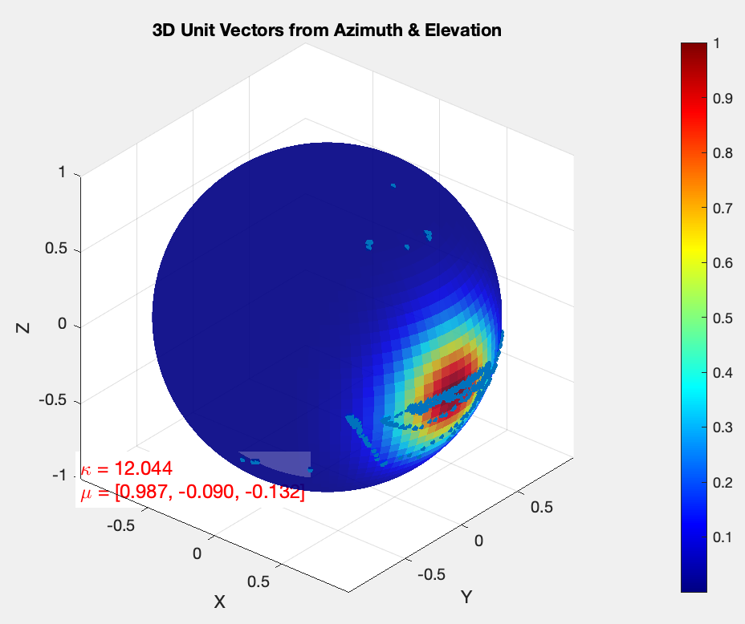
Distribution parameters of azimuth and elevation - made-data-test-3

Slide 15
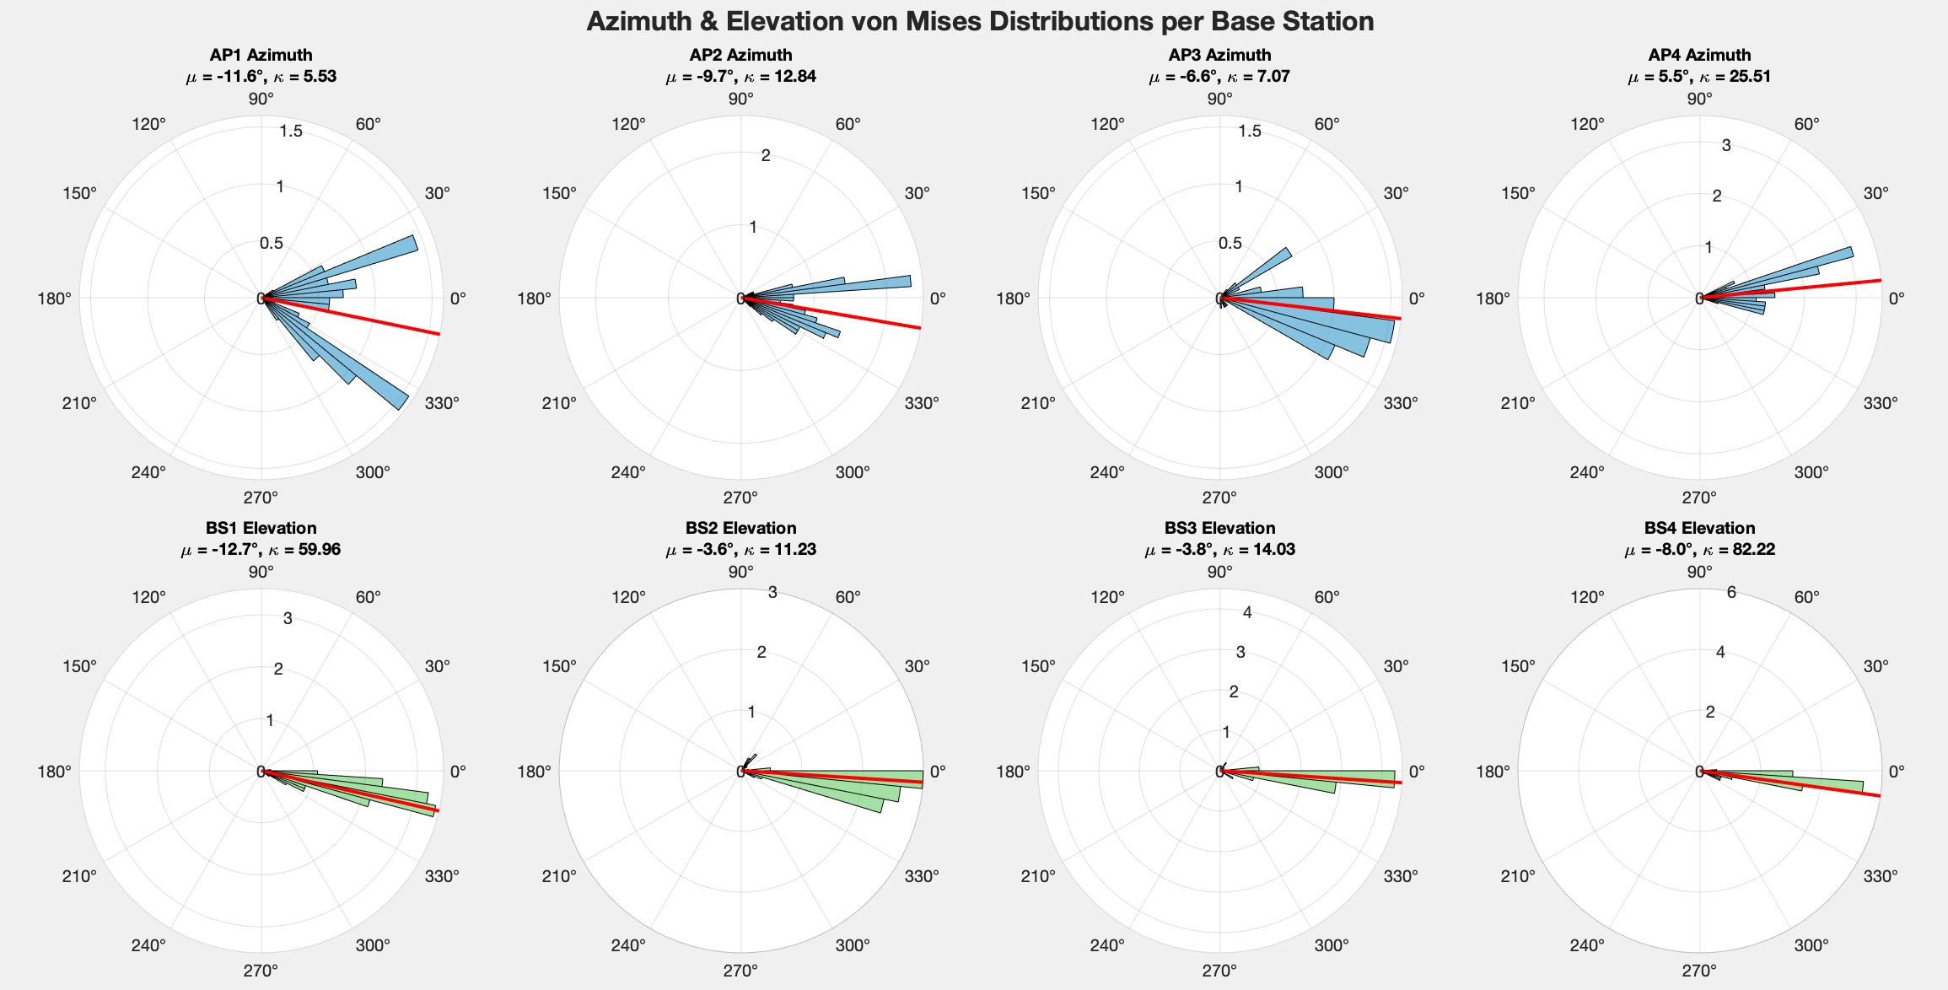
Distribution parameters of azimuth and elevation - made-data-test-1 - VM per AP

Slide 16
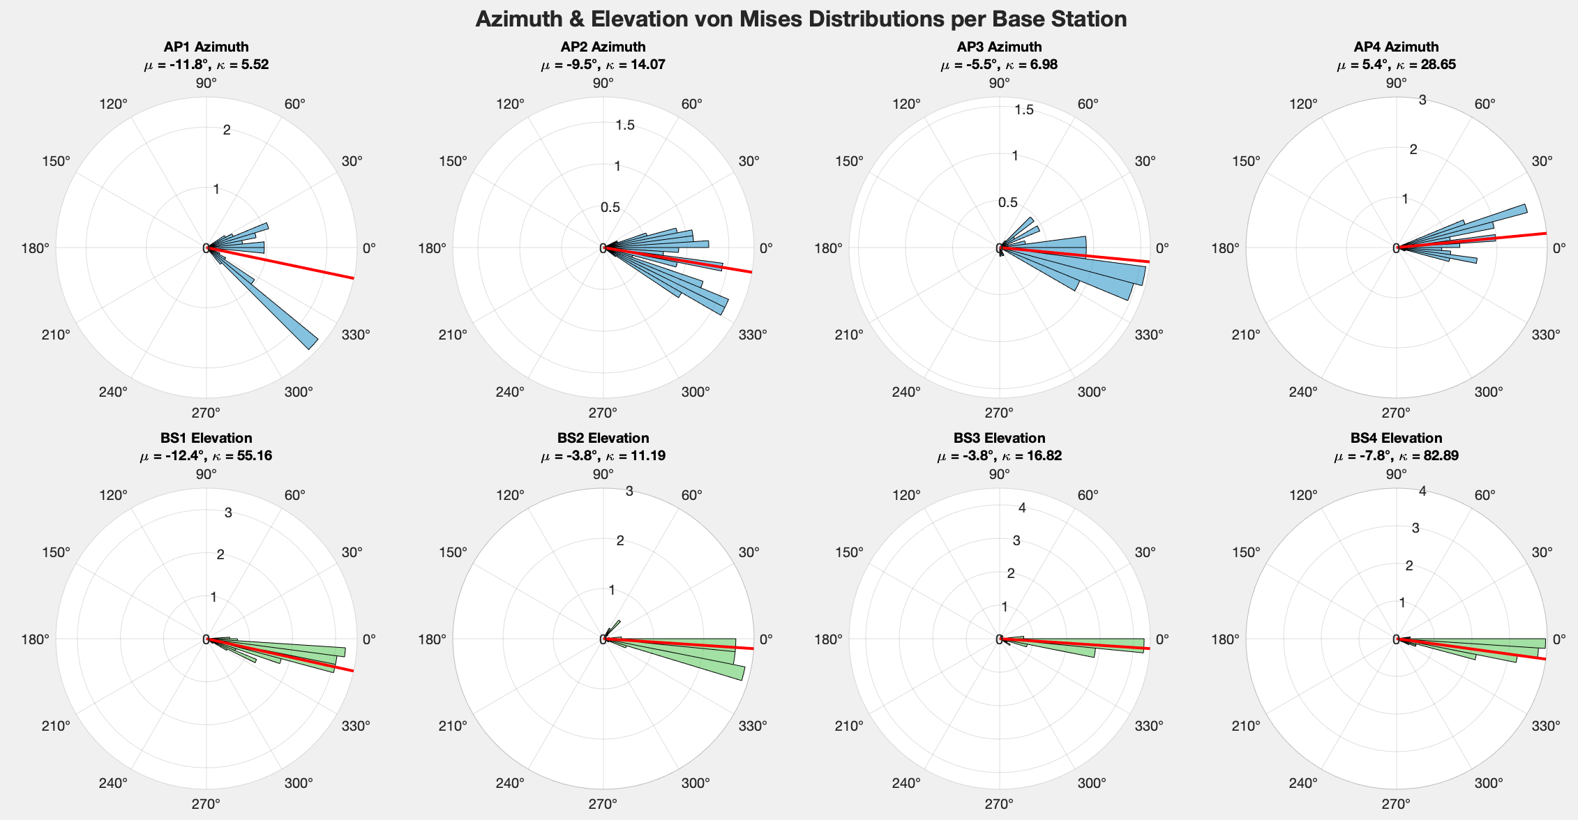
Distribution parameters of azimuth and elevation - made-data-test-2 - VM per AP

Slide 17
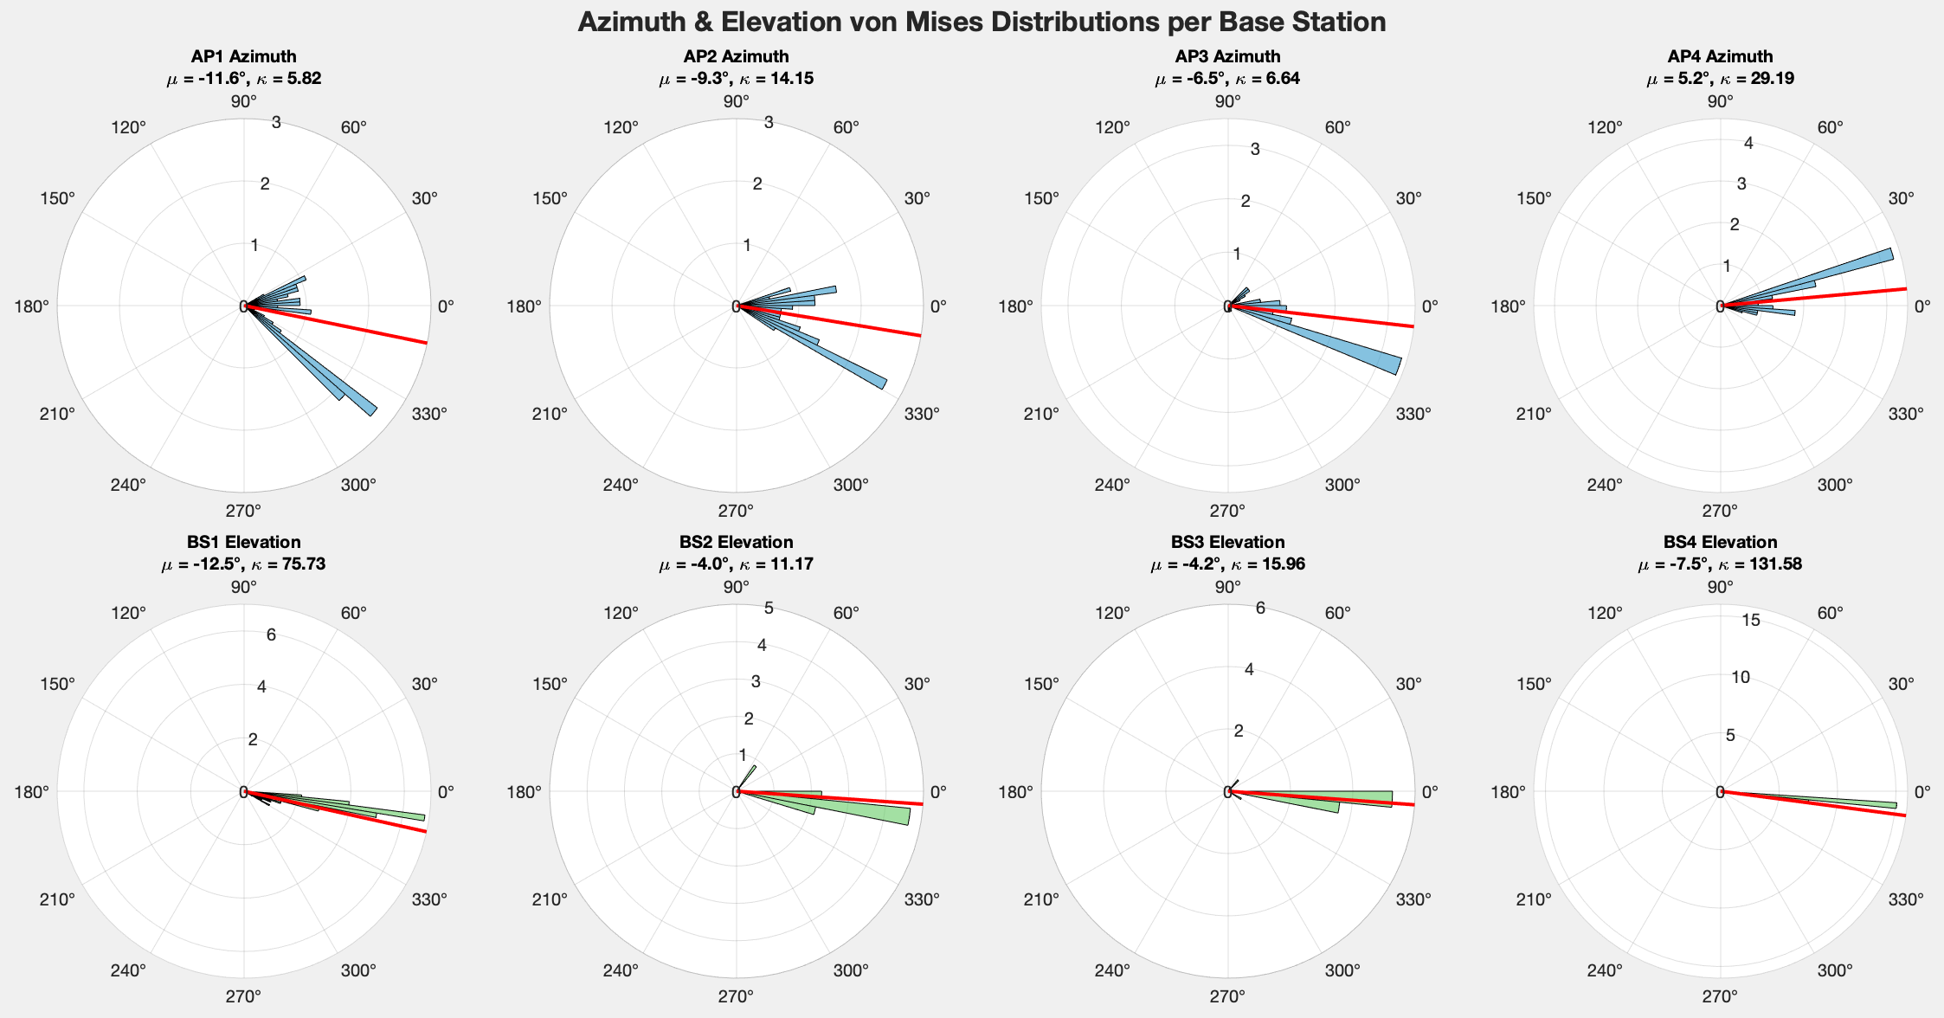
Distribution parameters of azimuth and elevation - made-data-test-3 - VM per AP

Slide 18
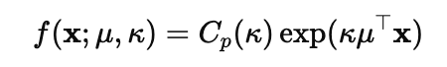
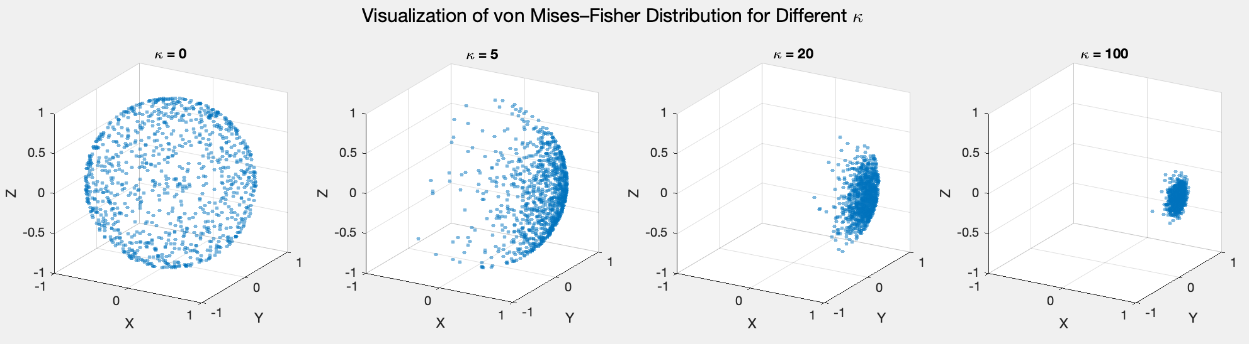
von Mises–Fisher (VMF) Distribution
Given a mean direction vector μ (unit vector) and concentration parameter κ (kappa), the VMF probability density function is:
x : a unit vector on the sphere
C_{p}(κ) : the normalization constant.
𝜇 : Mean direction (unit vector) representing the expected direction
κ : Concentration parameter controlling how tightly the distribution clusters around
( κ=0 corresponds to a uniform distribution on the sphere. κ means stronger concentration towards 𝜇 )

Slide 19
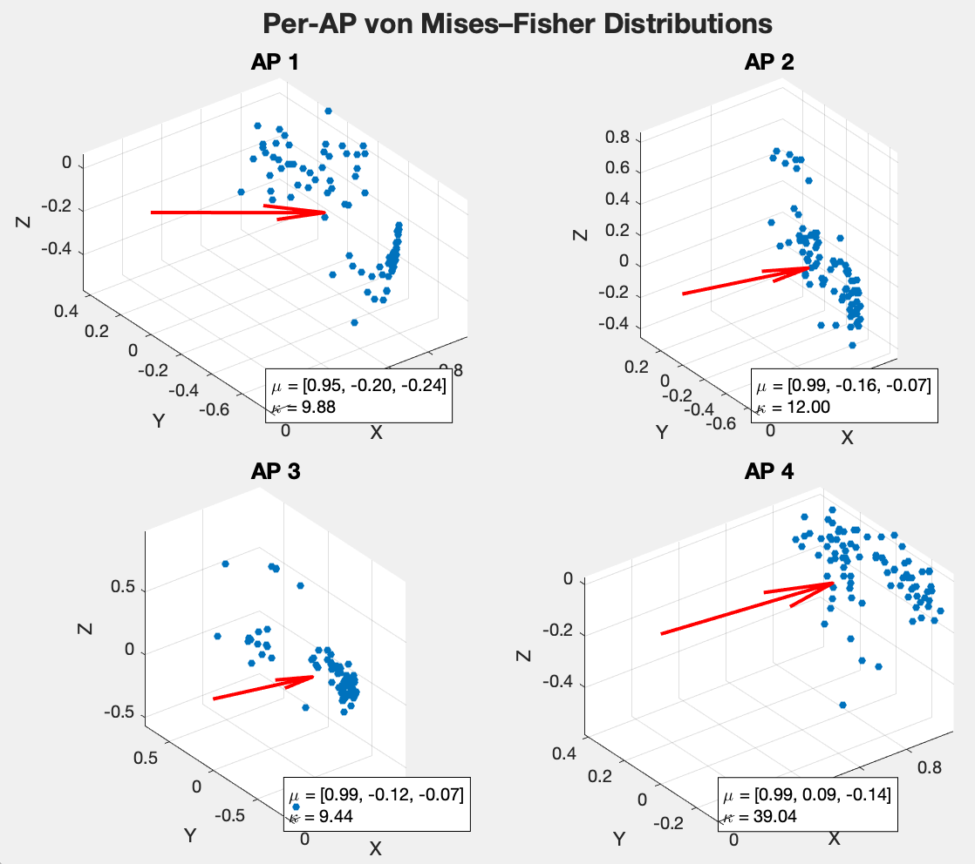
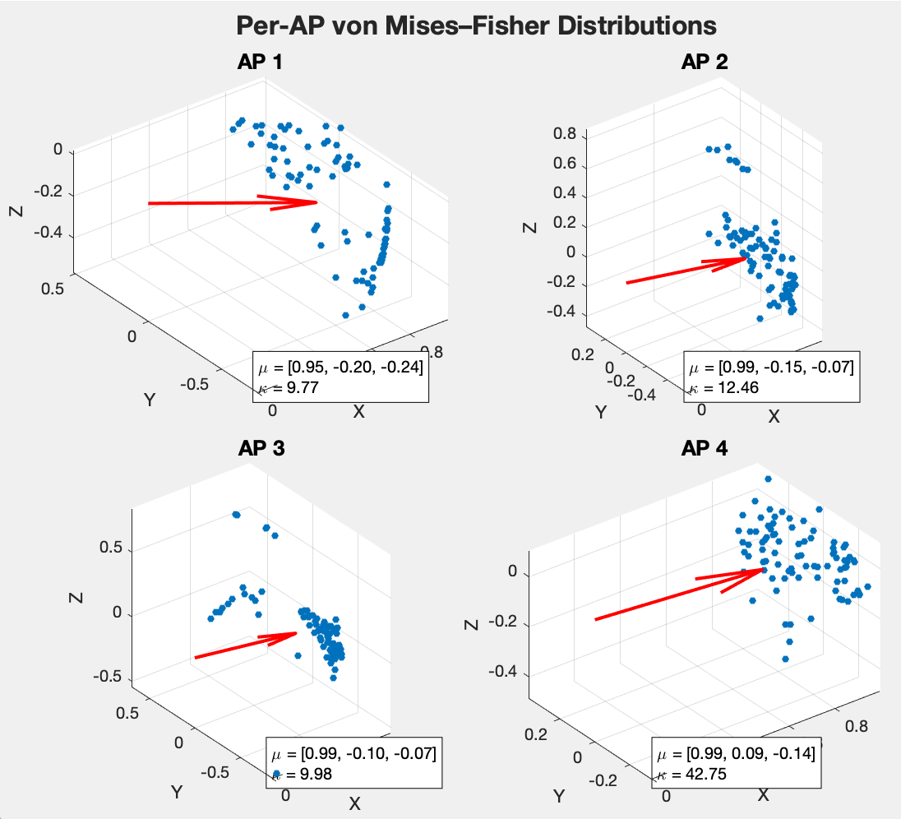
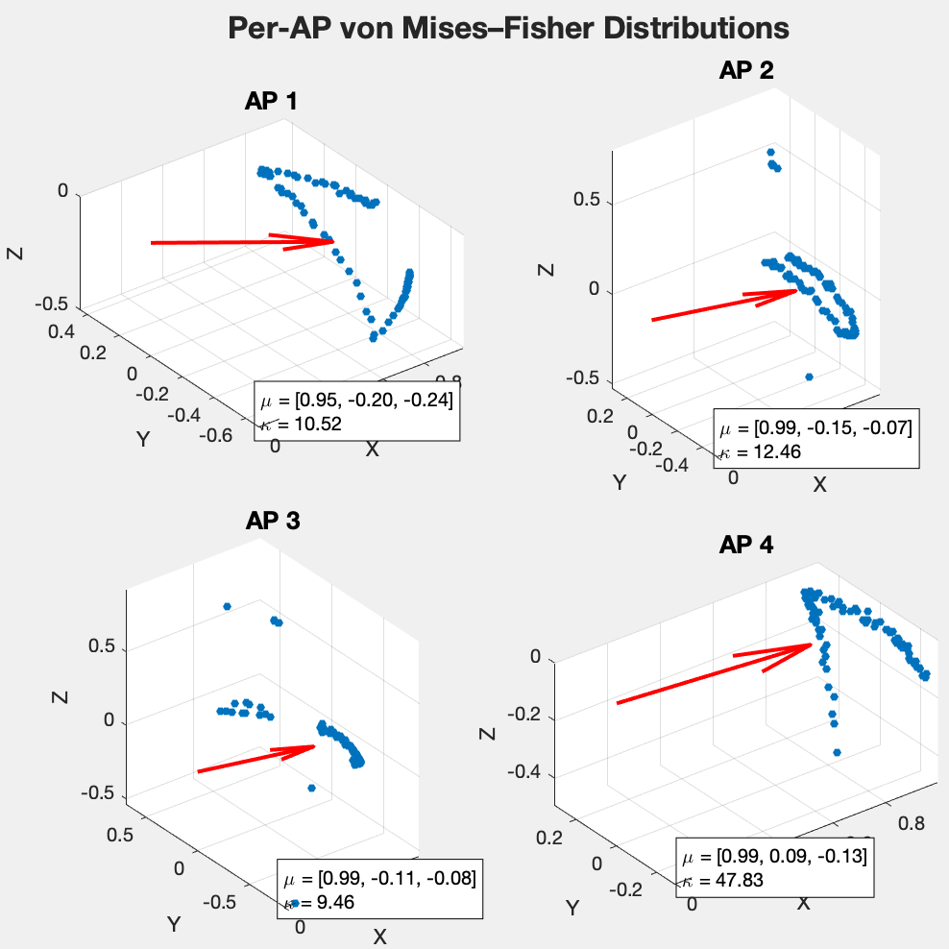
Distribution parameters of azimuth and elevation - VMF per AP
1
2
3

Slide 20
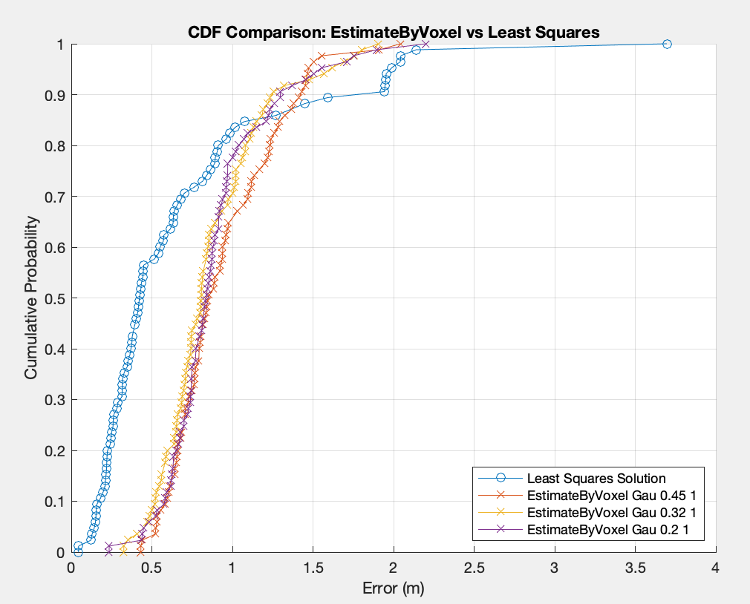
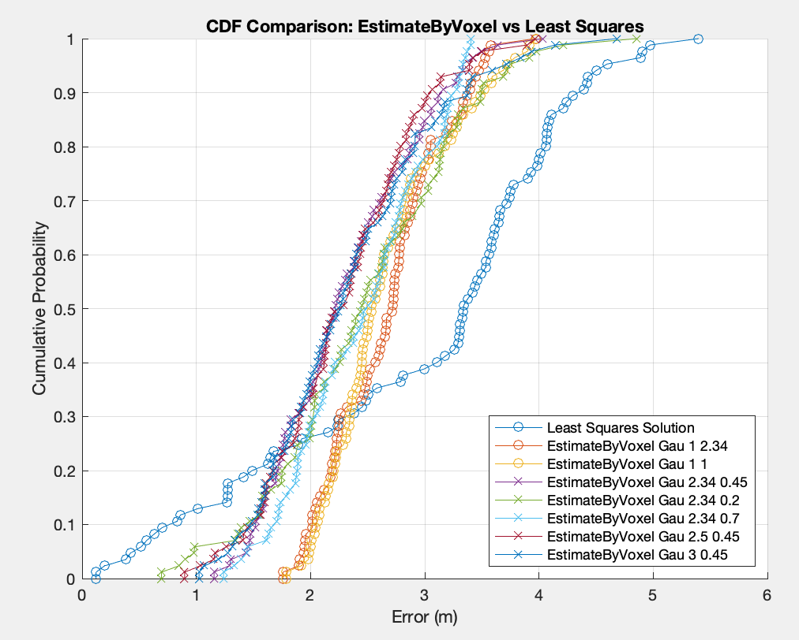
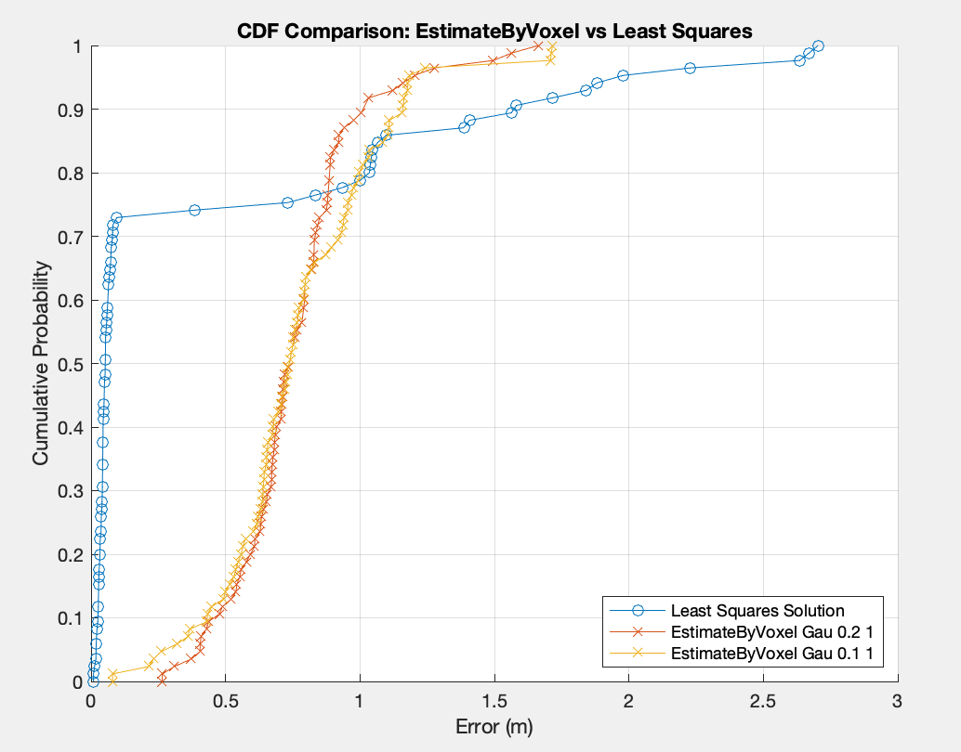
result
1
2
3

Slide 21
CONTATTI
xuan3.zhang@mail.polimi.it

